Slide 1
MoGliFC
BEC 6s->10V
ELRS ?
STM32H743
UART 1-8
PWM1-8
BEC 6s->5V
ADC 1-4
BEEPER
LDO MCU 5V->3.3V
WIFI
WS2811 LED PWM
LDO SENS 5V->3.3V
LEDs:
3V3 (r)
FC stat1 (g)
FC stat2 (b)
BEC VX 6s->5V
Servo Out 1-8
Boot Switch
IMU BMI270
SPI1
I2C 2
Ext. I2C
OSD MAX7456
Ext. SPI ?
SPI2
FLASH W25N01G
SPI3
(FD-) CAN TJA1057GTK/3Z
BARO
DPS310
I2C 1
USB-C
MAG
HMC5883
I2C 1
SWD debug

Slide 2
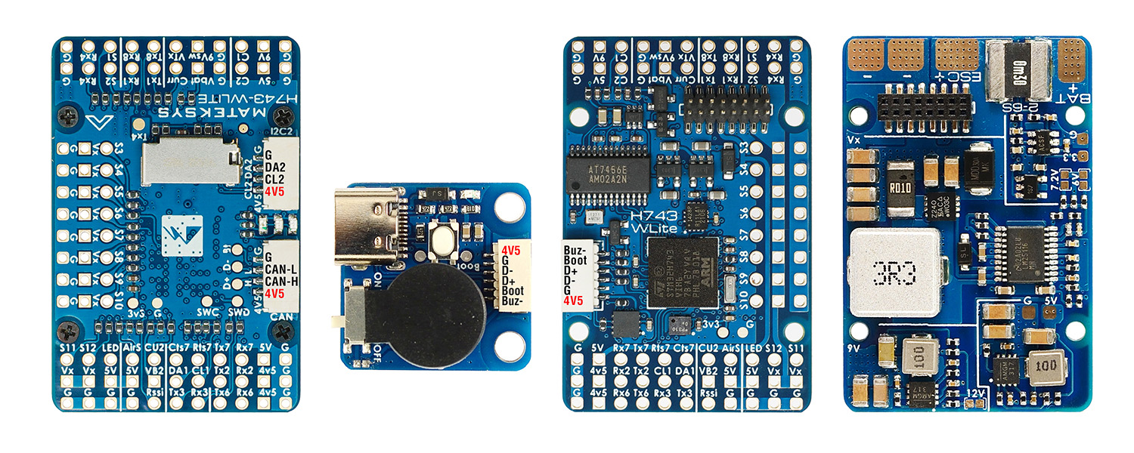
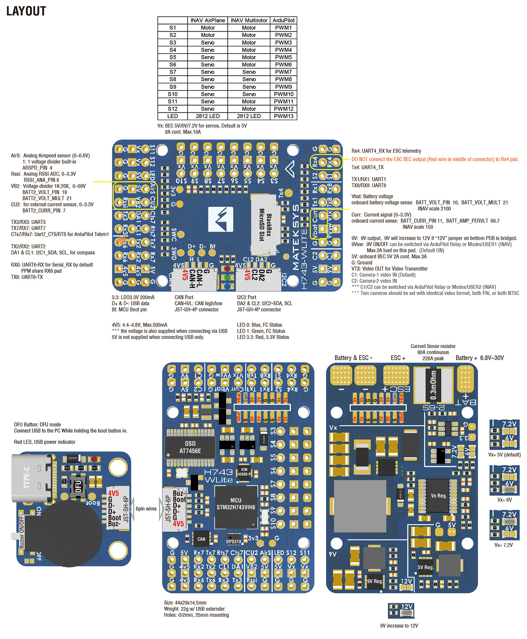
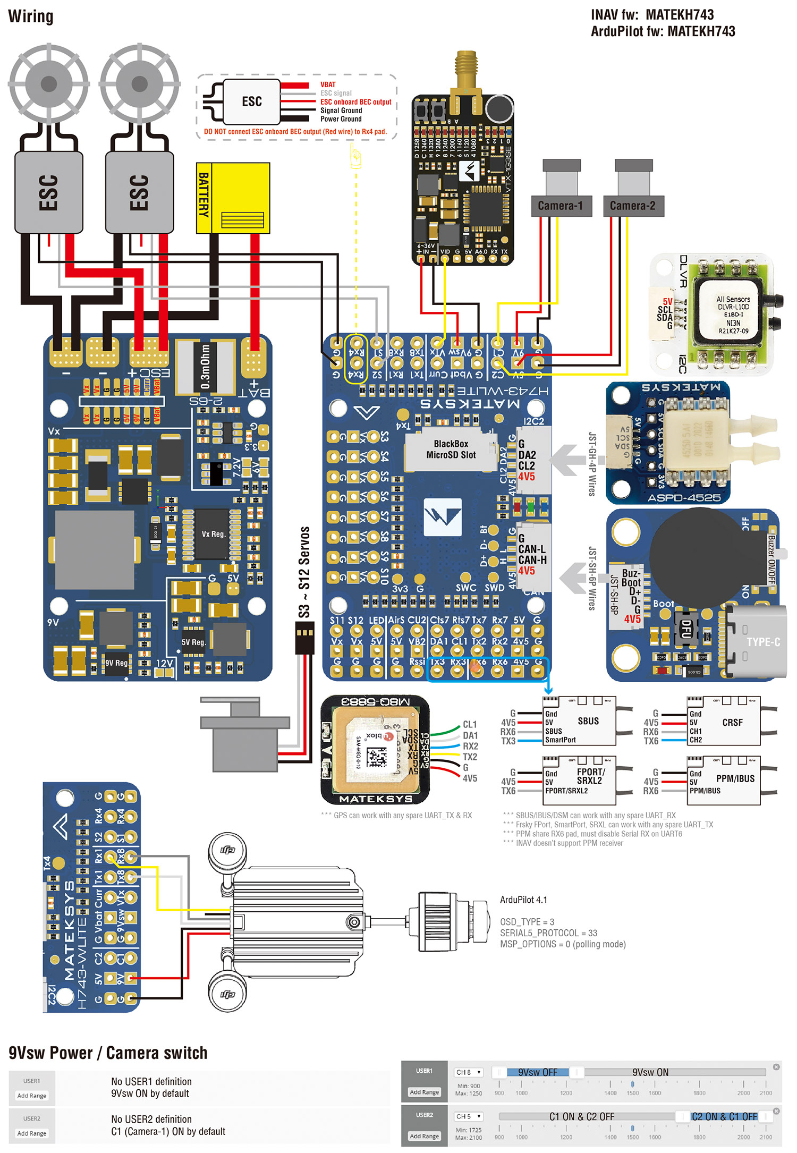
https://www.mateksys.com/?portfolio=h743-wlite
INAV
PWM | S1 | PB0 | 5 V tolerant I/O | TIM3_CH3 | Fixed Wing Motor
 | S2 | PB1 | 3.3 V tolerant I/O | TIM3_CH4
 | S3 | PA0 | 5 V tolerant I/O | TIM5_CH1 | Fixed Wing Servo
 | S4 | PA1 | 5 V tolerant I/O | TIM5_CH2
 | S5 | PA2 | 5 V tolerant I/O | TIM5_CH3
 | S6 | PA3 | 5 V tolerant I/O | TIM5_CH4
 | S7 | PD12 | 5 V tolerant I/O | TIM4_CH1
 | S8 | PD13 | 5 V tolerant I/O | TIM4_CH2
 | S9 | PD14 | 5 V tolerant I/O | TIM4_CH3
 | S10 | PD15 | 5 V tolerant I/O | TIM4_CH4
 | S11 | PE5 | 5 V tolerant I/O | TIM15_CH1
 | S12 | PE6 | 5 V tolerant I/O | TIM15_CH2
 | LED | PA8 | 5 V tolerant I/O | TIM1_CH1 | 2812LED
ADC | Vbat pad 1K:20K divider builtin | PC0 | 0~36V | Vbat ADC ADC_CHANNEL_1 | scale 2100
 | Curr Pad | PC1 | 0~3.3V | Current ADC ADC_CHANNEL_2 | scale 150
 | RSSI Pad | PC5 | 0~3.3V | RSSI ADC ADC_CHANNEL_3 | Analog RSSI
 | AirS Pad 20K:20K divider builtin | PC4 | 0~6.6V | AirS ADC ADC_CHANNEL_4 | Analog Airspeed
 | VB2 Pad 1K:20K divider builtin | PA4 | 0~69V | ADC_CHANNEL_5 | scale 2100
 | CU2 Pad | PA7 | 0~3.3V | ADC_CHANNEL_6 | spare
I2C | I2C1 CL1/DA1 | PB6/PB7 | 5 V tolerant I/O | Compass | QMC5883 / HMC5883 IST8310 / IST8308 MAG3110 / LIS3MDL
 |  |  |  | OLED | 0.96″
 | I2C2 CL2/DA2 on JST-GH-4P | PB10/PB11 | 5 V tolerant I/O | onboard Barometer | DPS310, Add: 0x76
 |  |  |  | Digital Airspeed sensor | MS4525
 |  |  |  | Temperature sensor
UART | USB | PA11/PA12 | 5 V tolerant I/O | USB
 | TX1 RX1 | PA9/PA10 | 5 V tolerant I/O | USART1 | telem2
 | TX2 RX2 | PD5/PD6 | 5 V tolerant I/O | USART2 | GPS1
 | TX3 RX3 | PD8/PD9 | 5 V tolerant I/O | USART3 | GPS2
 | TX4 RX4 | PB9/PB8 | 5 V tolerant I/O | UART4 | USER
 | TX6 RX6 | PC6/PC7 | 5 V tolerant I/O | TX6 & RX6 | CRSF
 |  |  |  | UART6_RX | SBUS/IBUS/DSM/PPM
 |  |  |  | UART6_TX | FPORT/SRXL2
 | RX7 TX7 | PE7/PE8 | 3.3 V tolerant I/O | UART7 | telem1
 | TX8 RX8 | PE1/PE0 | 5 V tolerant I/O | UART8 | USER

Slide 3
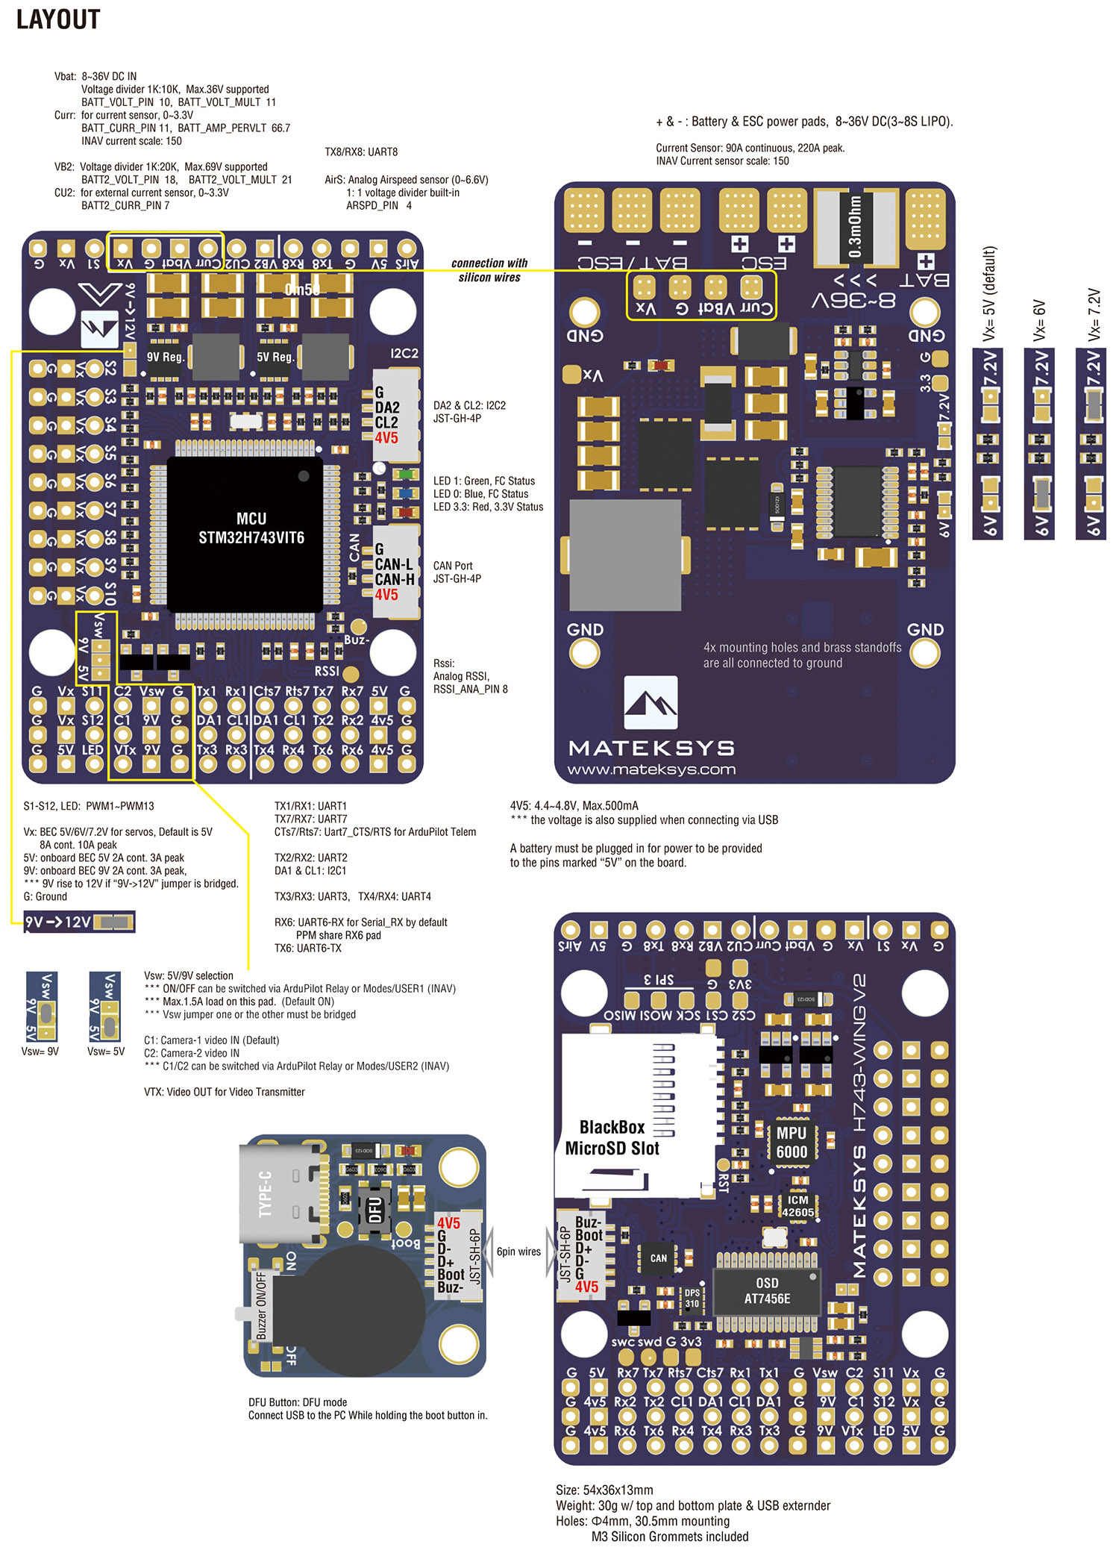
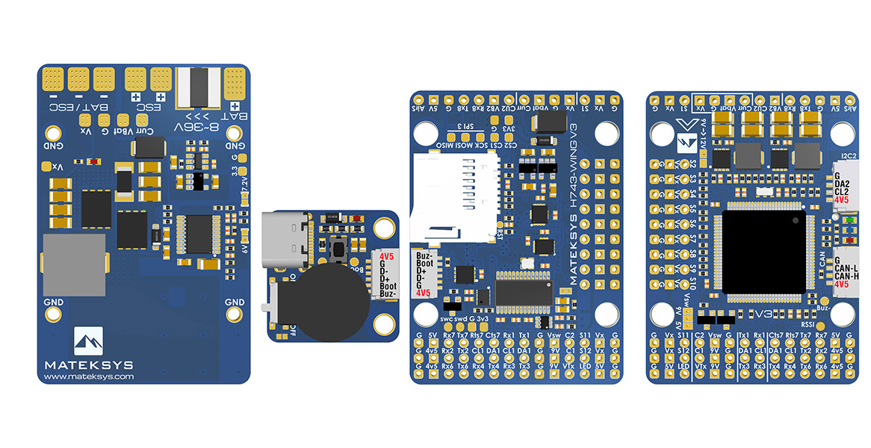
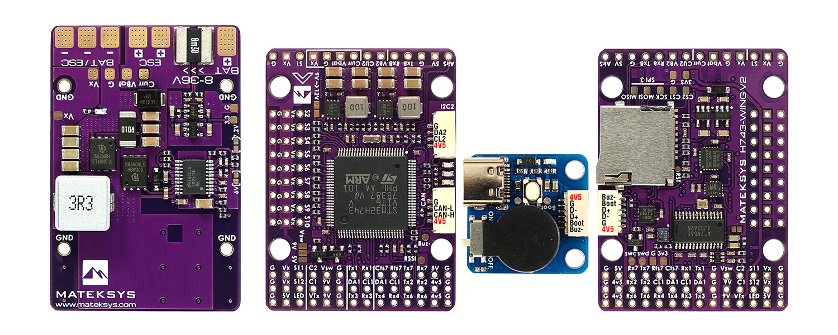
https://www.mateksys.com/?portfolio=h743-wing-v2
INAV
PWM | S1 | PB0 | 5 V tolerant I/O | TIM3_CH3 | Fixed Wing Motor
 | S2 | PB1 | 3.3 V tolerant I/O | TIM3_CH4
 | S3 | PA0 | 5 V tolerant I/O | TIM5_CH1 | Fixed Wing Servo
 | S4 | PA1 | 5 V tolerant I/O | TIM5_CH2
 | S5 | PA2 | 5 V tolerant I/O | TIM5_CH3
 | S6 | PA3 | 5 V tolerant I/O | TIM5_CH4
 | S7 | PD12 | 5 V tolerant I/O | TIM4_CH1
 | S8 | PD13 | 5 V tolerant I/O | TIM4_CH2
 | S9 | PD14 | 5 V tolerant I/O | TIM4_CH3
 | S10 | PD15 | 5 V tolerant I/O | TIM4_CH4
 | S11 | PE5 | 5 V tolerant I/O | TIM15_CH1
 | S12 | PE6 | 5 V tolerant I/O | TIM15_CH2
 | LED | PA8 | 5 V tolerant I/O | TIM1_CH1 | 2812LED
ADC | Vbat pad 1K:10K divider builtin | PC0 | 0~36V | Vbat ADC ADC_CHANNEL_1 | scale 1100
 | Curr Pad | PC1 | 0~3.3V | Current ADC ADC_CHANNEL_2 | scale 150
 | RSSI Pad | PC5 | 0~3.3V | RSSI ADC ADC_CHANNEL_3 | Analog RSSI
 | AirS Pad 20K:20K divider builtin | PC4 | 0~6.6V | AirS ADC ADC_CHANNEL_4 | Analog Airspeed
 | VB2 Pad 1K:20K divider builtin | PA4 | 0~69V | ADC_CHANNEL_5 | scale 2100
 | CU2 Pad | PA7 | 0~3.3V | ADC_CHANNEL_6 | spare
I2C | I2C1 CL1/DA1 | PB6/PB7 | 5 V tolerant I/O | Compass | QMC5883 / HMC5883 IST8310 / IST8308 MAG3110 / LIS3MDL
 |  |  |  | OLED | 0.96″
 | I2C2 CL2/DA2 on JST-GH-4P | PB10/PB11 | 5 V tolerant I/O | onboard Barometer | DPS310
 |  |  |  | Digital Airspeed sensor | MS4525
 |  |  |  | Temperature sensor
UART | USB | PA11/PA12 | 5 V tolerant I/O | USB
 | TX1 RX1 | PA9/PA10 | 5 V tolerant I/O | USART1 | telem2
 | TX2 RX2 | PD5/PD6 | 5 V tolerant I/O | USART2 | GPS1
 | TX3 RX3 | PD8/PD9 | 5 V tolerant I/O | USART3 | GPS2
 | TX4 RX4 | PB9/PB8 | 5 V tolerant I/O | UART4 | USER
 | TX6 RX6 | PC6/PC7 | 5 V tolerant I/O | TX6 & RX6 | CRSF
 |  |  |  | UART6_RX | SBUS/IBUS/DSM/PPM
 |  |  |  | UART6_TX | FPORT/SRXL2
 | RX7 TX7 | PE7/PE8 | 3.3 V tolerant I/O | UART7 | telem1
 | TX8 RX8 | PE1/PE0 | 5 V tolerant I/O | UART8 | USER

Slide 5
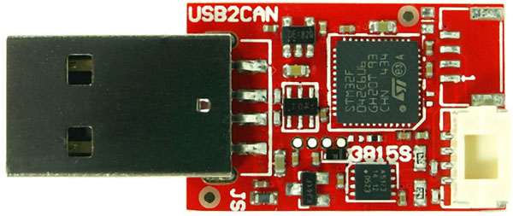
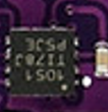
CAN
Pixhawk: TJA1051TK

